Slide 1


Smart Light: A Distributed On-device Voice-controlled LED Prototype
EITP40 - Final Project Presentation
Presented by Group 7 Qingtong You, Qiying Chen, Siwei Jiang, Junzhang Chen
19/12/2025

Slide 2
Outline
1
Introduction
2
System Overview
3
Technical Details
4
Result Evaluation
5
Discussion & Future Work

Slide 3
Outline
1
Introduction
2
System Overview
3
Technical Details
4
Result Evaluation
5
Discussion & Future Work

Slide 4
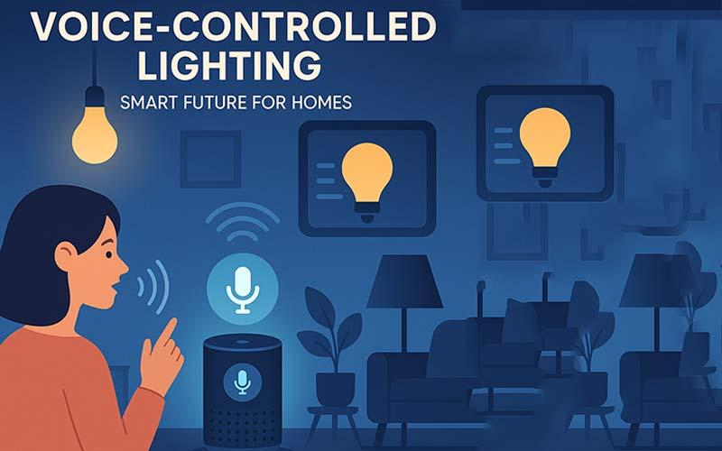
Introduction
Voice Recognition
On-device Training
Real-time Inference
Federated Learning
Privacy Protection

Slide 5
Introduction
Data Collection
Siwei Jiang &
Junzhang Chen
Voice Recording (2 Users)
Audio Preprocessing
Data Labeling & Organization
ML Algorithm and Implementation on IoT Sensor
Qingtong You
& Qiying Chen
Model Design
Feature Extraction
Federated Learning
BLE Communication
Hardware Setup
Evaluation and Results
Siwei Jiang &
Junzhang Chen
Local Accuracy
Cross-user Accuracy
Federated Accuracy

Slide 6
Outline
1
Introduction
2
System Overview
3
Technical Details
4
Result Evaluation
5
Discussion & Future Work

Slide 7
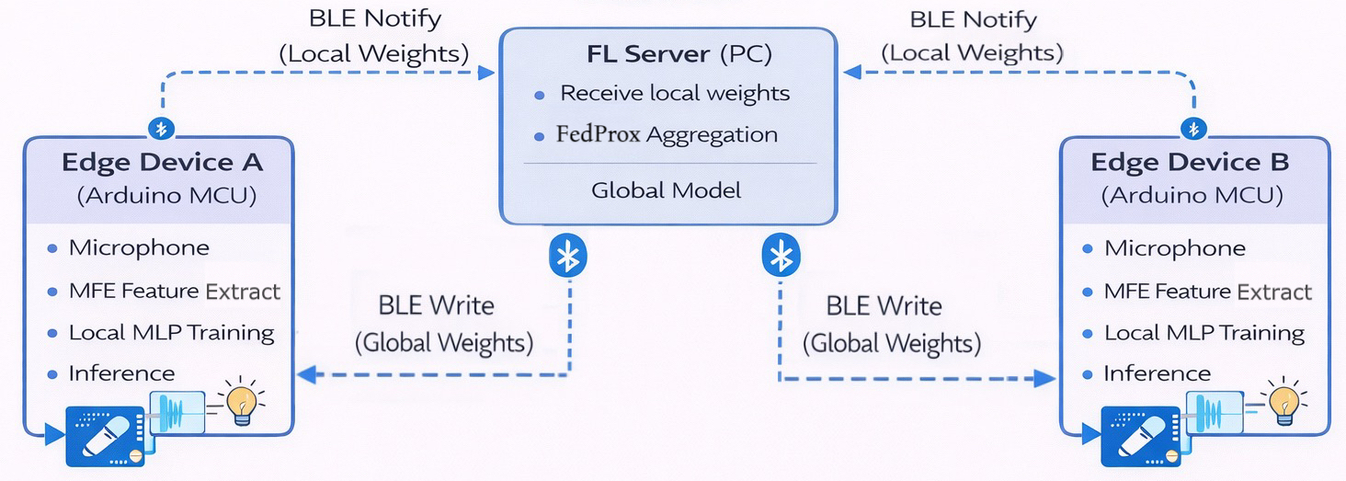
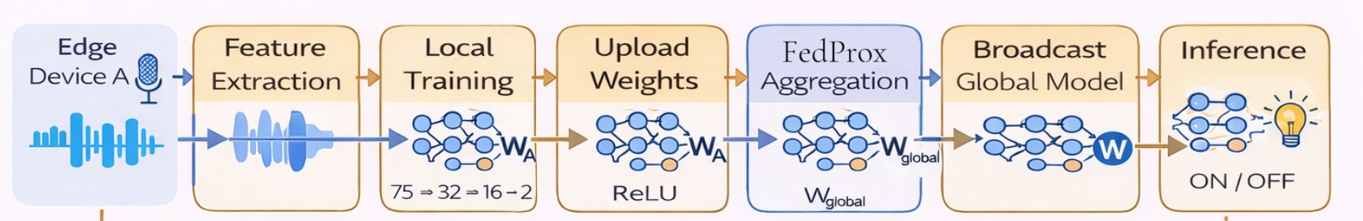
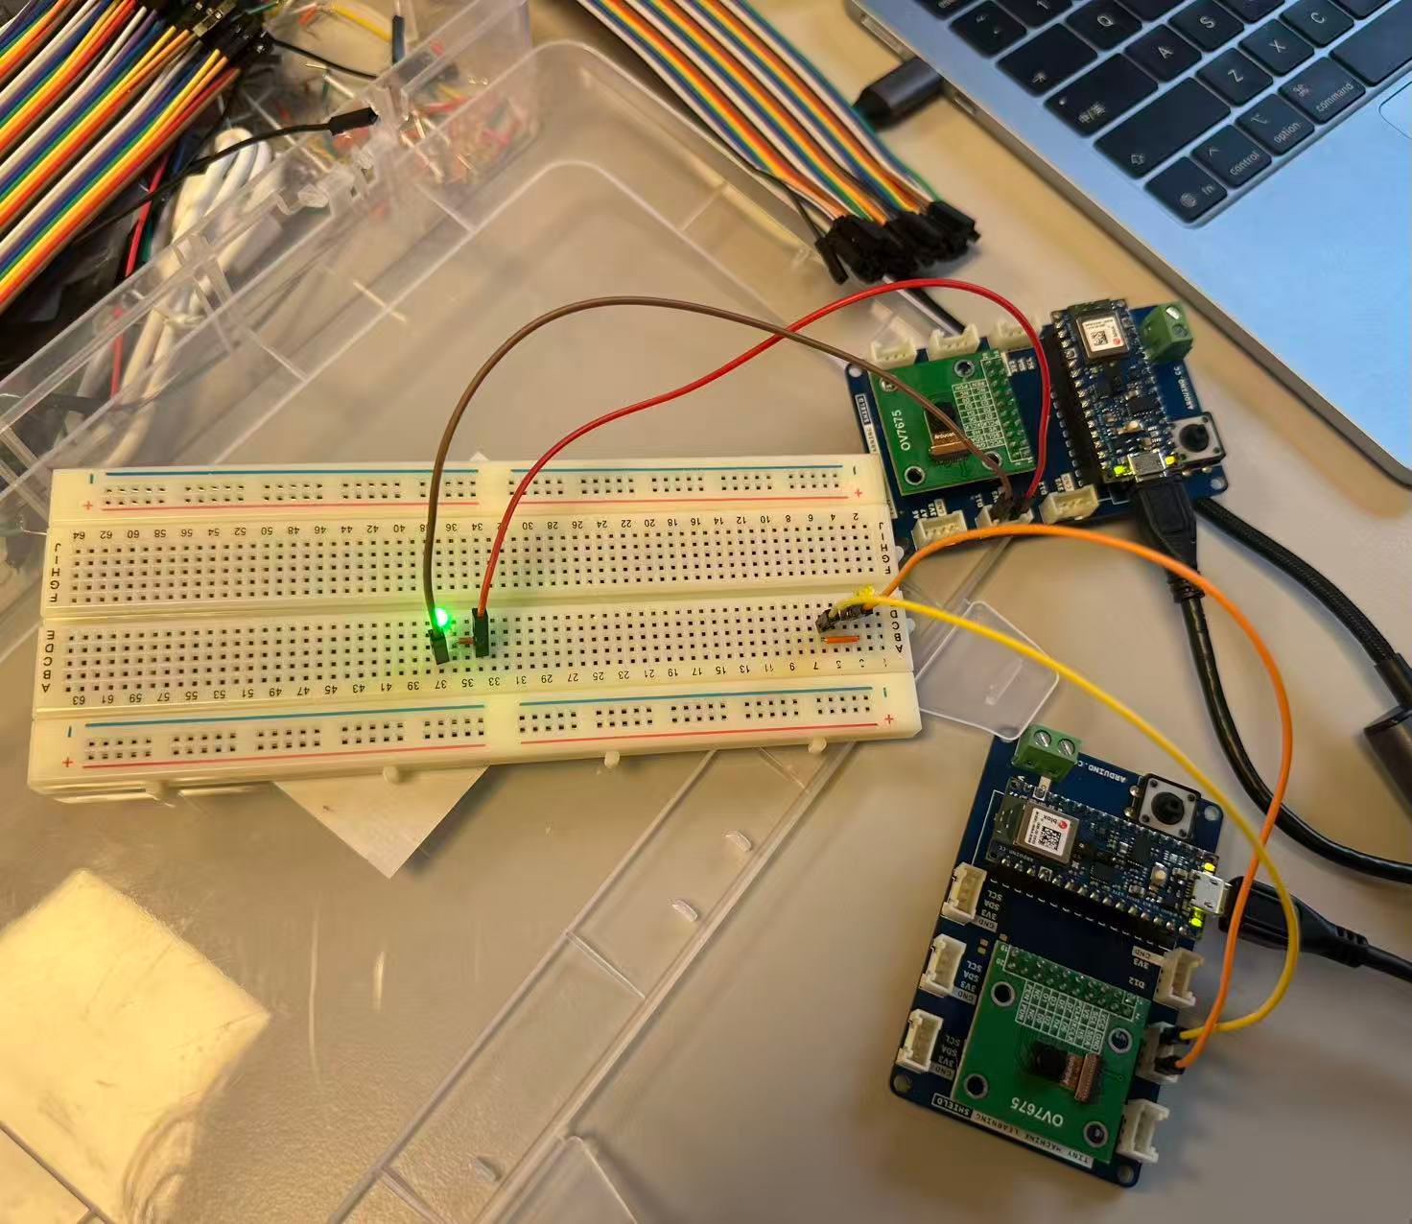
System Overview

Slide 8
Outline
1
Introduction
2
System Overview
3
Technical Details
4
Result Evaluation
5
Discussion & Future Work

Slide 9
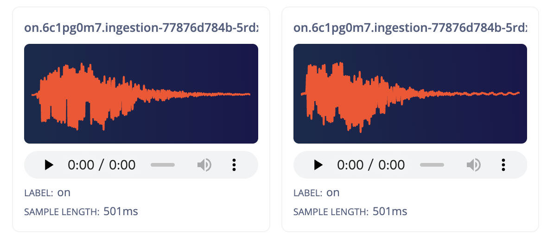
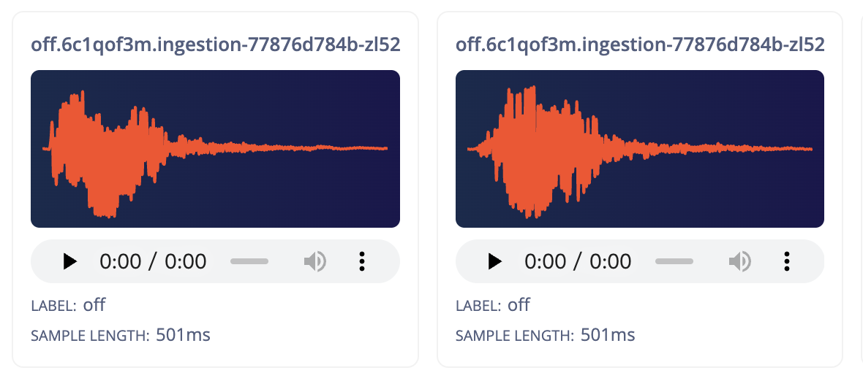
Technical Details |Data Collection
Data collection using MCU Mic
Voice data trimming and alignment
Data Conversion & MCU Loading
Classes: on/off
Users: 1 male and 1 female
Train : Val : Test: ~6:2:2
Total Samples: 260/222
Uniform Trimming: All samples clipped to 500ms (8000 points).
Onset Alignment: Aligning the start point with the voice energy onset.
Optimization: Simplifying data patterns to enhance training efficiency and inference accuracy.
Int16 PCM Export: Directly extract the MCU's native int16 PCM audio data and stored as C arrays for subsequent pre-processing.

Slide 10
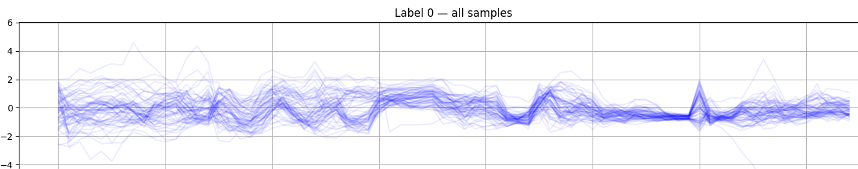
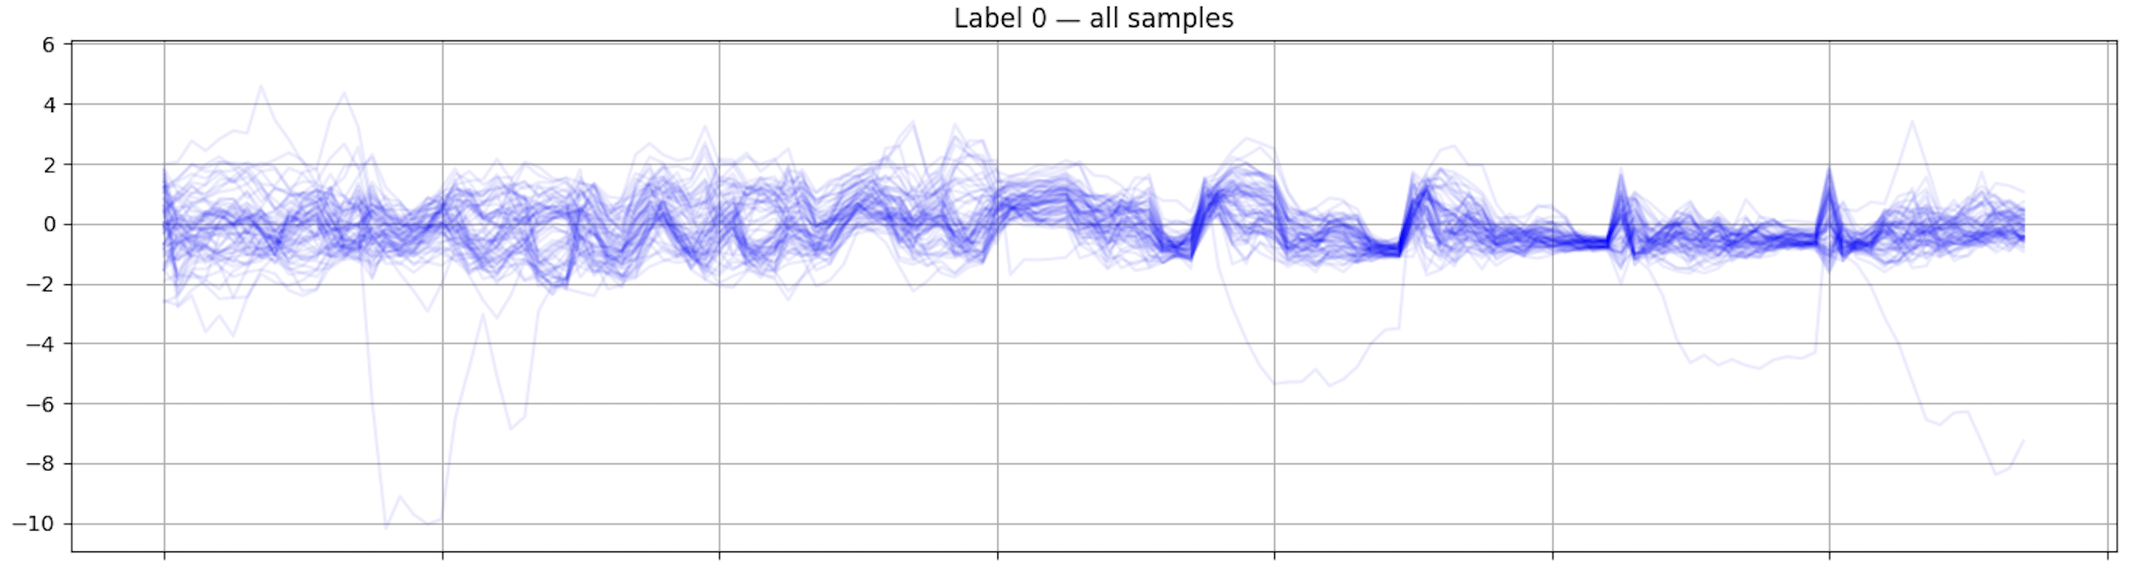
Technical Details |Feature Extraction
.wav file
Essential spectral
energy information
Low dimensions data
Normalization
mean+std
eliminate amplitude variations
Energy calculation
for each spectrum
MFE
MFCC
FFT
Mel filterbank
MFE+Log+DCT
loss local spectral-band information
75 points mfe
PC (offline)
MFE computation
Extracted feature dataset
135 points mfe
Arduino (On-device)
Same C++ implementation
Real-time audio features
for inference

Slide 11
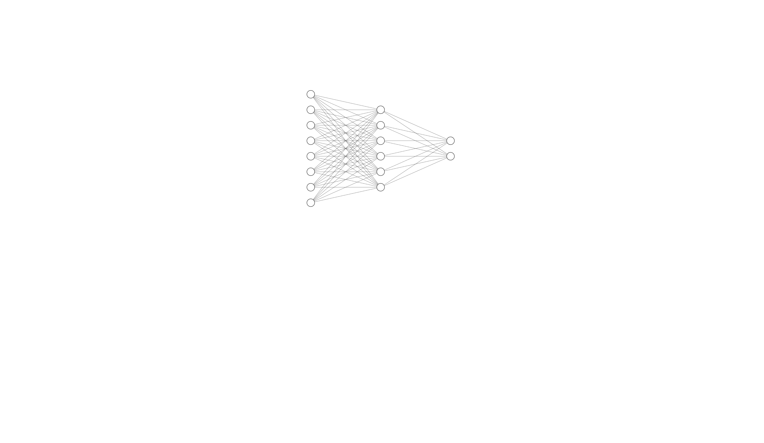
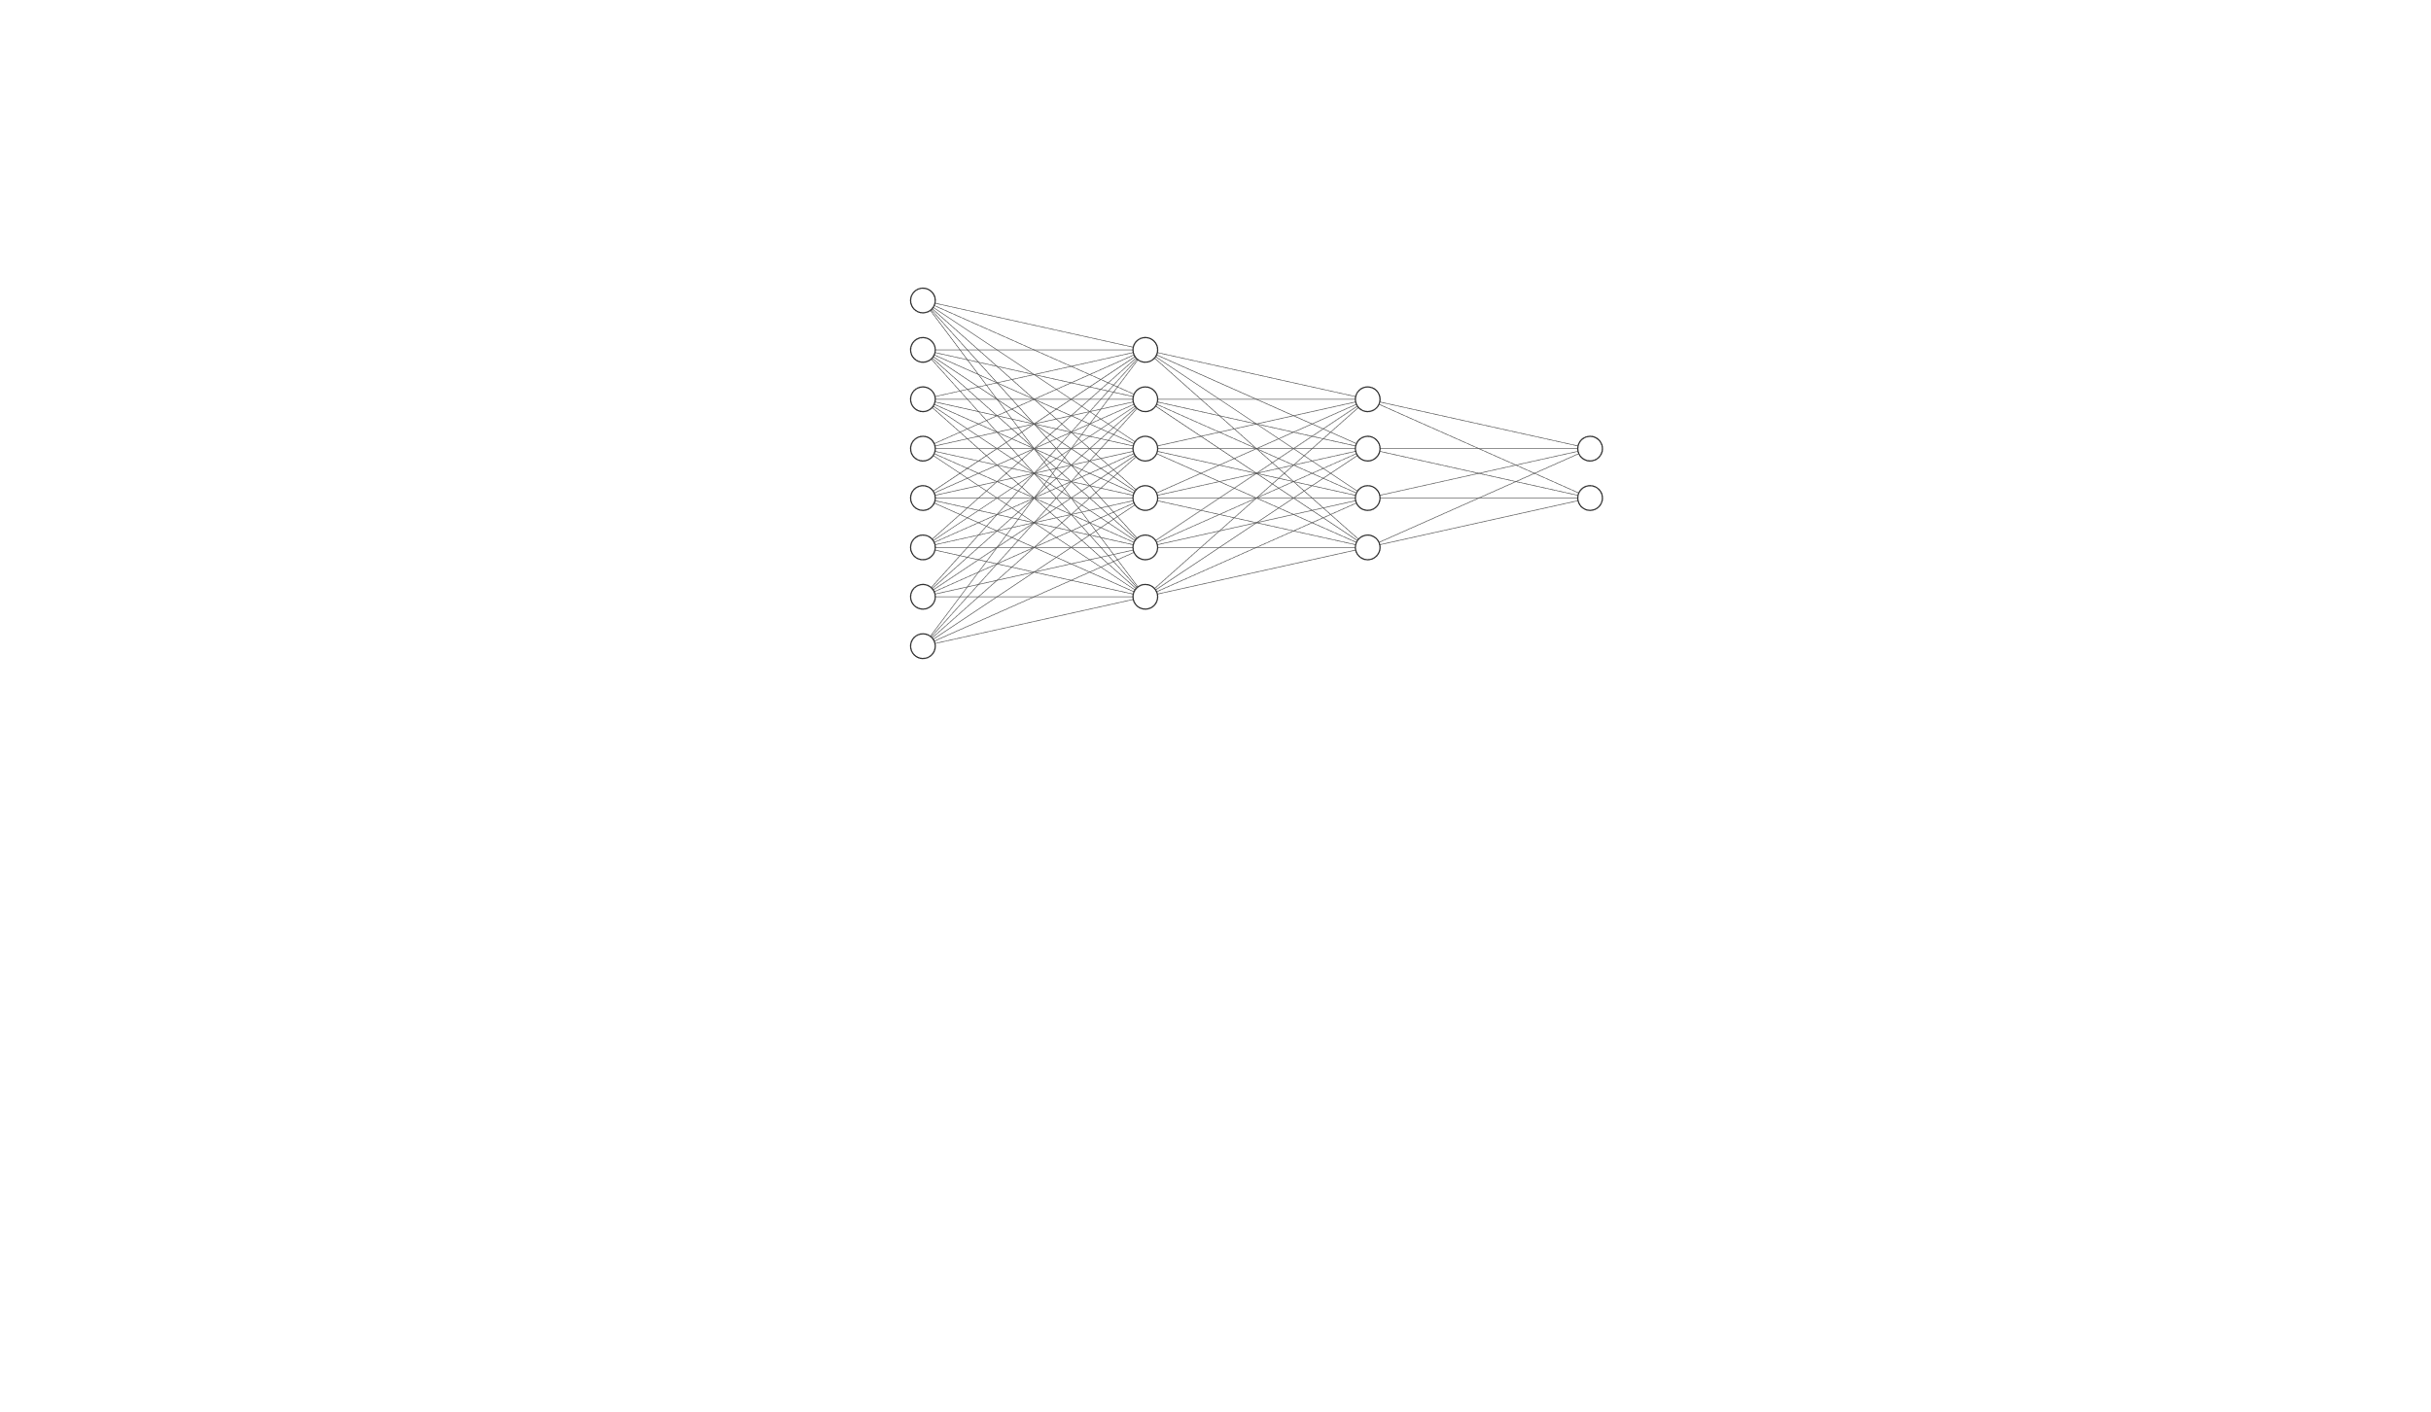
Technical Details |Model
Goal: Robust on-device real-time inference
Model Architecture Exploration
Based on light-weight MLP
Slightly increase model depth to two hidden layer
2994 parameters, still affordable!
1 hidden layer
Classification Strategy
Explicit ‘unknown’ class is ideal in principle, but difficult for this lightweight MLP
Confidence-based rejection used instead
Reject the command if softmax confidence < 0.6
2 classes or 3 classes? That’s a question!
🤔
2 hidden layer

Slide 12
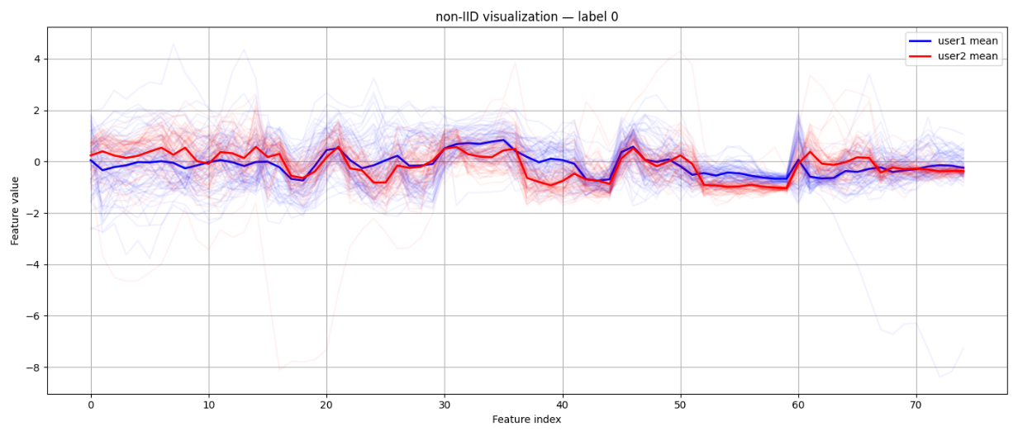
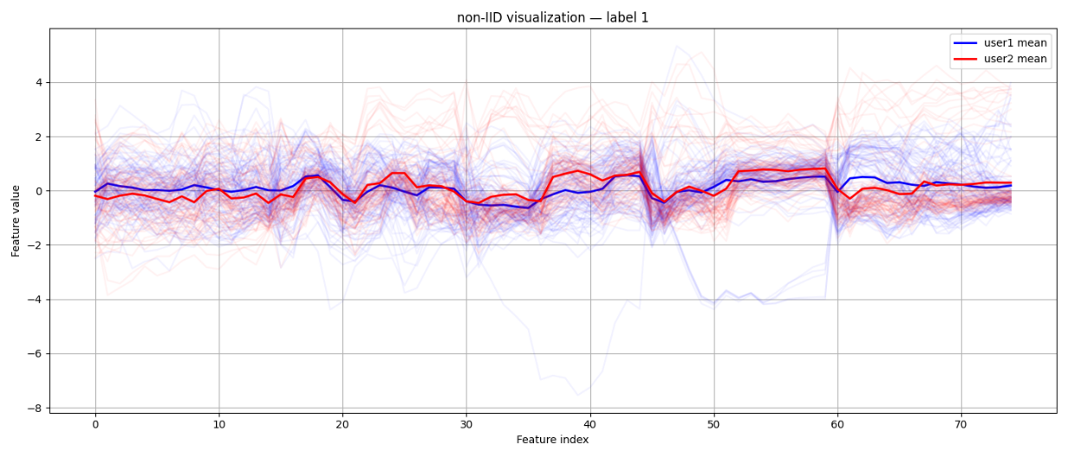
Technical Details |Challenges & System Setup
Challenge: Offline test samples are normalized by training set, how about online inference?
Ideally, we can use global normalization parameters calculated by the federated weight, but...
Normalization for Federated Real-time Inference
Feature distributions are non-IID across users
Global normalization parameters become misaligned
Lead to distorted feature scaling during real-time inference
Local normalization better preserves user-specific statistics

Slide 13

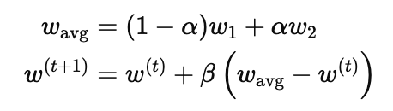
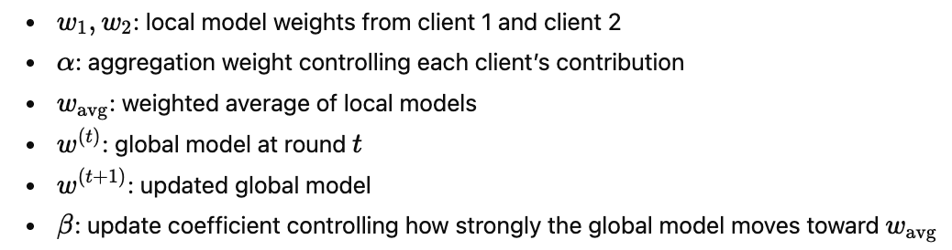

Technical Details |Federated Learning
Model Setup
6 epoch local training on each edge device
FedAveg
User accent and different local optimization direction
Small local dataset and parameter drift
Each 3 epoch as a round to use BLE to notify local weights to FL server
In FL server, apply FedProx(Federated Proximal Optimization) to generate global weights
Send global weight to each edge device
FedProx
User 2 Accuracy After 10 FL rounds | Train | Val | Test
 | 0.90 | 0.92 | 0.77
 | 0.92 | 0.92 | 0.88
Before FedProx
After FedProx
Future work:
Asynchronous Federated Learning (practical engineering scenarios)

Slide 14
Outline
1
Introduction
2
System Overview
3
Technical Details
4
Result Evaluation
5
Discussion & Future Work

Slide 15
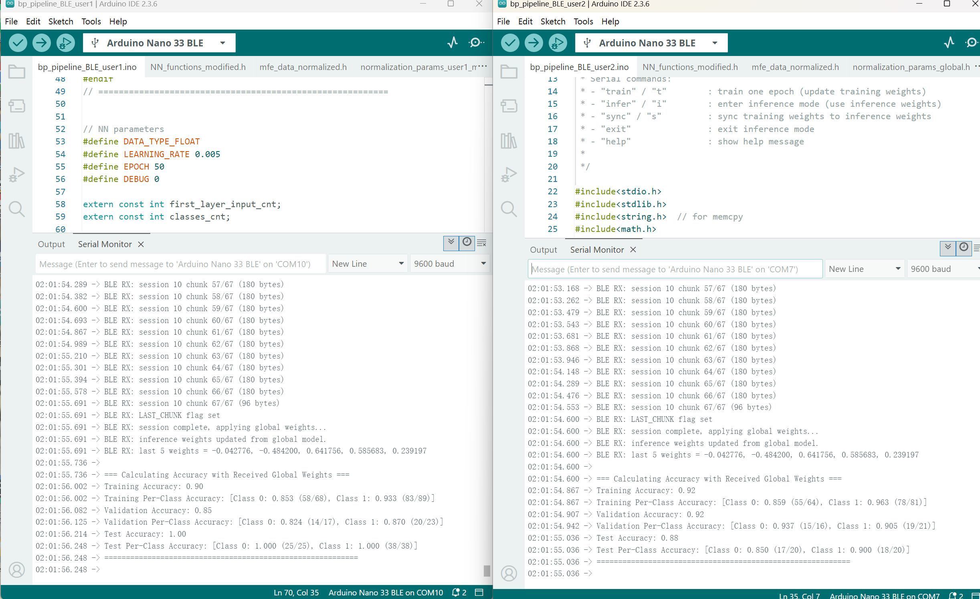
Result Evaluation

Slide 16
Outline
1
Introduction
2
System Overview
3
Technical Details
4
Result Evaluation
5
Discussion & Future Work

Slide 17
Thanks for Listening!
Smart Light: A Distributed On-device Voice-controlled
LED Prototype
Qingtong You, Qiying Chen, Siwei Jiang, Junzhang Chen

